Slide 1

FrogPlay
Games based revision
www.frogplay.net

Slide 2
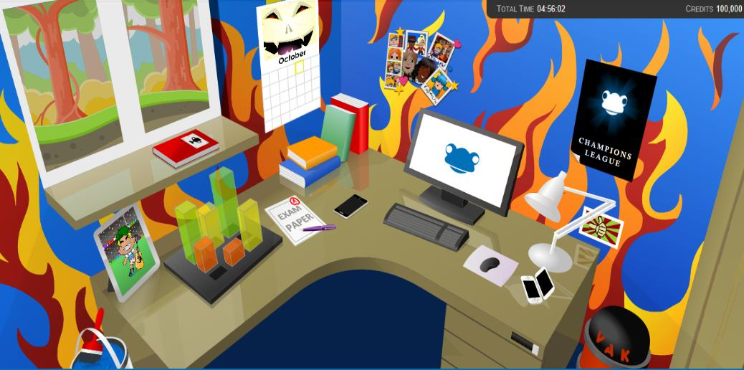
What is FrogPlay?
FrogPlay is a games based revision system
…helping you with your revision, study, knowledge building, assessment and exam practice
…helping you achieve!
www.frogplay.net

Slide 3

Proven to raise results
Impact Report:
Average results improvement 8.6% over an academic year
Average results for users spending 1 hour per week - 13.5%
Sample size of 202,515 learners, between 5 and 16 years old
www.frogplay.net

Slide 4
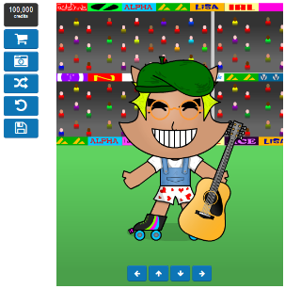
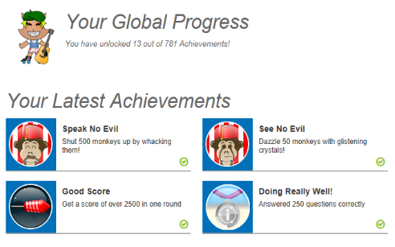
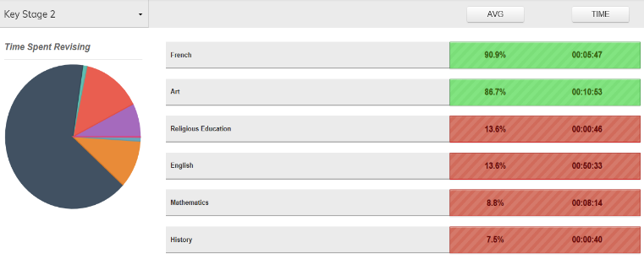
Your revision tool
FrogPlay gives you ownership of your environment
You can personalise the look and feel
Build an avatar to represent you in the games, leaderboards and with buddies
You choose what, when and how to revise
You can see your achievements (and be rewarded!)
You can clearly see your areas in need of improvement
www.frogplay.net

Slide 5
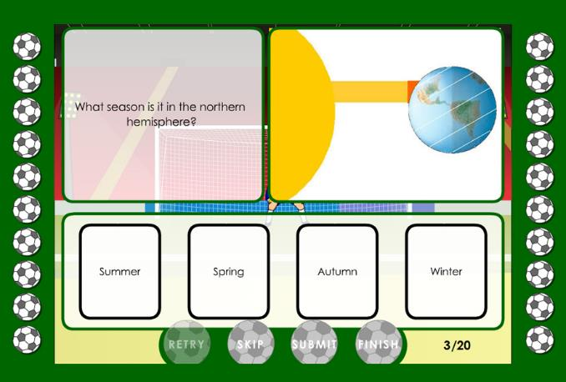
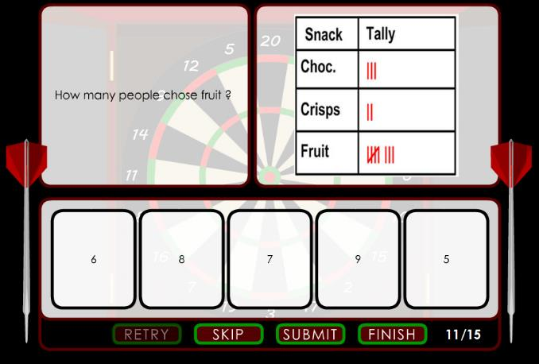
How does it work?
You build knowledge and understanding through interactive tasks
Answer curriculum linked questions:
www.frogplay.net

Slide 6
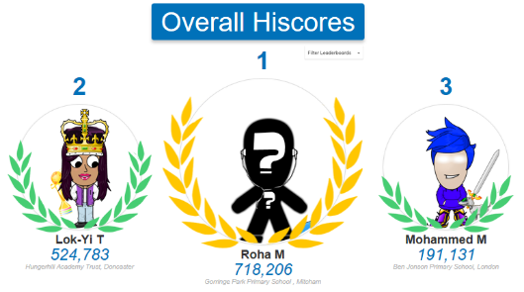
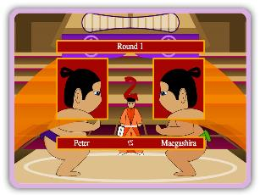

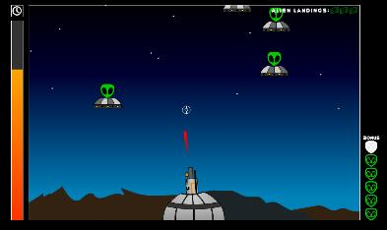
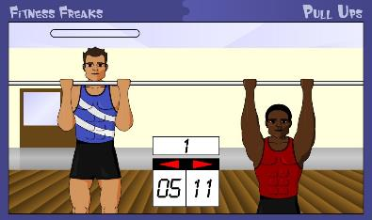
How does it work?
Answer questions correctly to improve your chance of success in the games
Can you get in the worldwide league top 10?
Play the game (choosing from over 100):
www.frogplay.net

Slide 7
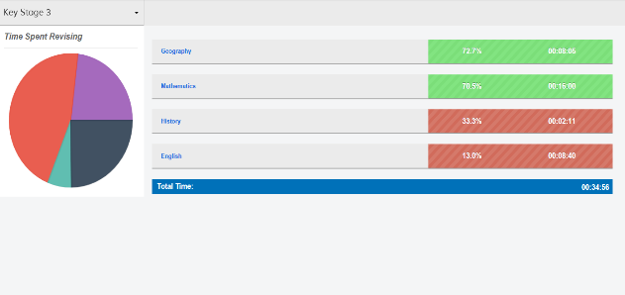
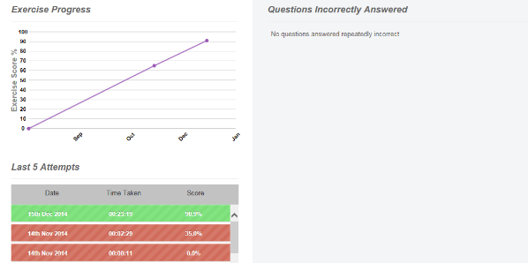
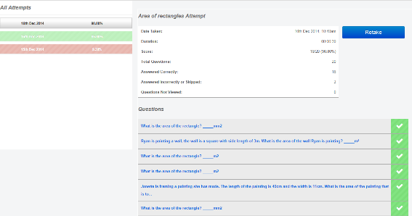
How does it work?
Celebrate success, tackle weak knowledge areas and see your progress
See the results:
www.frogplay.net

Slide 8
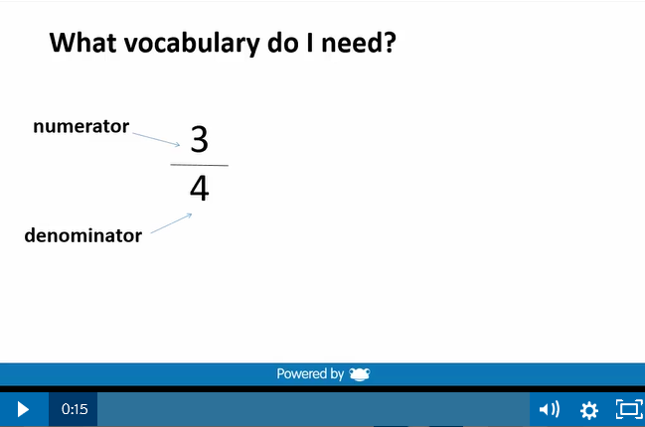

Watch the video
Watch the short videos recorded by teachers to help you improve English and Mathematics and then retry the quiz to see your improved knowledge
www.frogplay.net

Slide 9

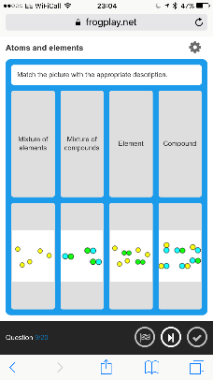
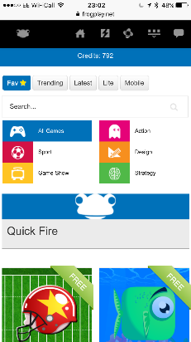
Anytime, Anywhere…
FrogPlay works best if you use it often!
Available on any internet enabled device
(even your mobile!!!)
www.frogplay.net

Slide 10
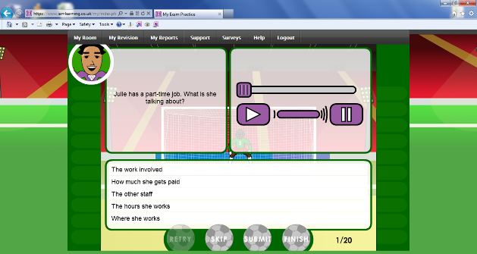
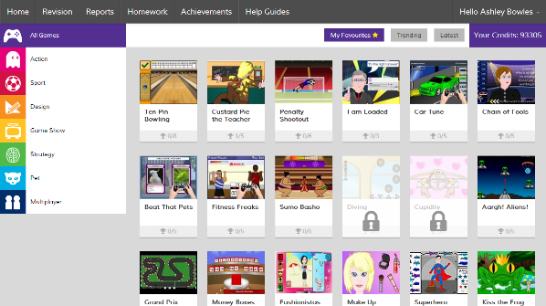
So…
Go to www.frogplay.net and login!
Use at the end of lessons / topic
Use for homework (set by your teachers)
Use to revise for exams
Use to build your own knowledge
Use for fun!!!
www.frogplay.net

Slide 11
Getting started
Go to www.frogplay.net and login!
Your School ID is: XXX
Your Username format is: forenamesurname
eg johnsmith
Your password format is: DOB – ddmmyyyy
eg 01062006
FrogPlay

Slide 12
Proven to raise results…
Impact Report:
Average results improvement 8.6% over an academic year
Average results for users spending 1 hour per week - 13.5%
This is your tool…use it!
FrogPlay
Games based revision

